Slide 1
Introduction to CSS

Slide 2
CSS, or Cascading Style Sheets, is a stylesheet language used to describe the presentation of an HTML document. It enhances the look and feel of web pages by controlling layout, colors, fonts, and more. Essentially, it separates content (HTML) from design
Advantages of Using CSS Over HTML.
Separation of Concerns: CSS separates content (HTML) from presentation (CSS), making the code more organized.
Reusability: You can reuse the same styles across multiple pages, saving time and effort.
Easier Maintenance: Updating styles becomes easier, as changes can be made in one place and reflected everywhere.
Improved Loading Speed: External CSS reduces duplication, making web pages load faster.
Consistency: Ensures consistent design across a website.

Slide 3
Properties and Their Values in CSS
CSS works with properties and their assigned values to style elements. For example:
Property: Specifies what to style (e.g., color, font-size, margin).
Value: Defines how the property is styled (e.g., red, 16px, 10px). Example:
p {
color: blue;
font-size: 14px;
}
.

Slide 4
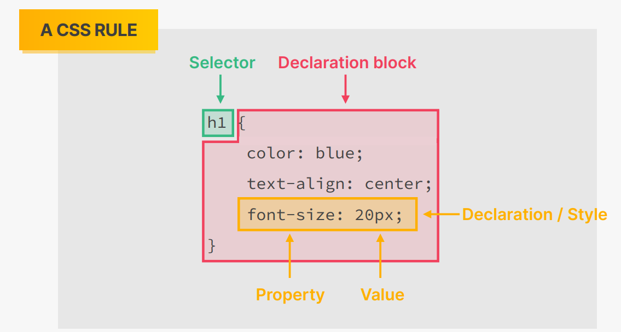

Slide 5
. Ways to Use CSS
There are three primary methods to apply CSS:
Inline CSS: Styling applied directly within an HTML element using the style attribute.
<p style="color: green;">This is green text.</p>
Internal CSS: Styles written within a <style> block in the <head> section of the HTML.
<style>
h1 {
font-size: 24px;
}
</style>
External CSS: Styles are stored in a separate .css file and linked to the HTML document.
<link rel="stylesheet" href="styles.css">

Slide 6
Why External CSS?
Scalability: External CSS is suitable for large projects with multiple pages.
Code Reusability: A single CSS file can be used across many HTML files.
Cleaner HTML: Keeps HTML code clutter-free and easier to read.

Slide 7
Comments in CSS
Comments are used to explain the code or to prevent parts of it from executing. In CSS, comments begin with /* and end with */. Example:
/* This is a comment */
body {
background-color: lightblue;
}

Slide 8
Discussion on Selectors
CSS selectors are patterns used to select and style specific elements in an HTML document. They help target HTML elements based on their attributes, relationships, or other identifiers, making it possible to apply styles efficiently.

Slide 9
Different Types of Selectors
CSS offers various types of selectors to provide flexibility when styling elements. Each type serves a different purpose.
Tag Selector
The tag (or element) selector targets all elements of a specific tag type. For example
h1 {
color: blue;
}
This applies the style to all <h1> elements.

Slide 10
Defining and Using Multi Selectors
h1, p {
color: green;
}
This applies the same color to both <h1> and <p> elements.

Slide 11
Defining and Using Class Selectors
Class selectors target elements that share the same class attribute. Defined using a period (.) followed by the class name:
.red-text {
color: red;
}
Usage in HTML:
<p class="red-text">This is red text.</p>

Slide 12
Multiple Classes on a Particular Tag
An element can have multiple classes, and CSS will apply all styles that match those classes. For example:
<p class="red-text bold-text">Styled with two classes.</p>
.red-text {
color: red;
}
.bold-text {
font-weight: bold;
}

Slide 13
Defining and Using ID Selectors
ID selectors target a single unique element based on its id attribute. Defined using a hash (#) followed by the ID name:
#main-heading {
font-size: 24px;
}
<h1 id="main-heading">This is the main heading.</h1>

Slide 14
Defining and Using Universal Selector
The universal selector (*) targets all elements in the document. For example:
* {
margin: 0;
padding: 0;
}
This resets the default margin and padding for all elements.
Why Universal Selector?
The universal selector is particularly useful when you want to apply a base style across all elements, such as resetting margins or setting a consistent font.

Slide 15
Defining and Using Attribute Selectors
Attribute selectors target elements based on their attributes and values. Examples:
Targeting by attribute:
[type="text"] {
border: 1px solid black;
}
<input type="text">

Slide 16
Use and Advantage of Using Pseudo-Classes
A pseudo-class defines the special state of an element. For example:
:hover targets an element when hovered over
button:hover {
background-color: lightblue;
}
Adds dynamic behavior without JavaScript.
Makes elements interactive (e.g., hover effects).

Slide 17
Defining Nested Selectors
Nested selectors style elements within a specific container or parent. Example:
.container p {
color: blue;
}
This applies styles to <p> tags inside elements with the class container.

Slide 18
Discussion on Pseudo-Elements
Pseudo-elements style specific parts of an element. Common examples include:
::before: Adds content before an element:
p::before {
content: "Note: ";
}
::after: Adds content after an element:
p::after {
content: " End.";
}

Slide 19
Text formatting using CSS
Defining the Color and Size of Text
Color: The color property sets the text color
p {
color: blue;
}
Size: The font-size property specifies the size of the text.
h1 {
font-size: 24px;
}

Slide 20
Discussion on Different Measurement Units
CSS supports various units to define size, each with its purpose:
Absolute Units: Fixed sizes (e.g., px, cm, mm, in).
Example: font-size: 16px;
Relative Units: Scale relative to another element or context (e.g., em, %, rem, vw, vh).
Example: font-size: 1.2em; (scales relative to the parent element).
Removing Underline from Hyperlink
Hyperlinks are underlined by default. To remove the underline, use the text-decoration property:
a {
text-decoration: none;
}

Slide 21
Use of Text Transformation
The text-transform property modifies the case of text:
uppercase: Converts all text to uppercase.
lowercase: Converts all text to lowercase.
capitalize: Capitalizes the first letter of each word. Example:
h2 {
text-transform: uppercase;
}
Creating Text Shadow
The text-shadow property adds a shadow effect to text. Syntax:
text-shadow: horizontal-offset vertical-offset blur-radius color;
h1 {
text-shadow: 2px 2px 4px grey;
}

Slide 22
Page formatting using CSS
. Defining the Background
The background of a webpage can be set using CSS properties such as:
body {
background-color: lightblue; /* Sets a solid background color */
background-image: url('background.jpg'); /* Adds an image as background */
background-size: cover; /* Ensures the image covers the entire page */
}

Slide 23
Managing Image in Background
To control how an image appears in the background, you can use:
body {
background-image: url('background.jpg');
background-repeat: no-repeat; /* Prevents the image from repeating */
background-position: center; /* Positions image at center */
background-attachment: fixed; /* Keeps the background fixed while scrolling */
}

Slide 24
Managing Layout of Page Using Position
The position property in CSS helps control the placement of elements on a webpage:
.header {
position: absolute; /* Positions relative to the nearest positioned ancestor */
top: 20px;
left: 50px;
}

Slide 25
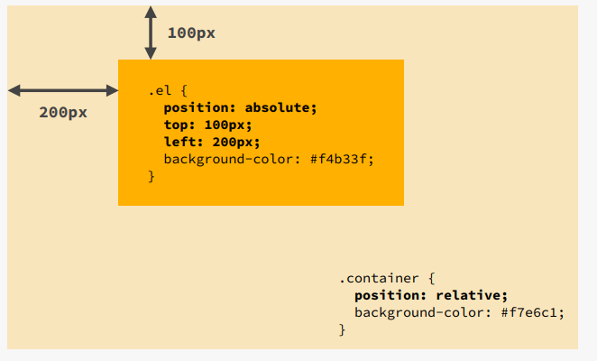

Slide 26
Difference Between Absolute, Relative, and Fixed Layout
Position Type | Description | Example
absolute | Positions element relative to the nearest positioned (not static) ancestor. | position: absolute; top: 20px; left: 30px;
relative | Positions element relative to its normal position. | position: relative; left: 20px;
fixed | Keeps element fixed at a position even when scrolling. | position: fixed; bottom: 0;
Example for Fixed Layout (Sticky Header):
.header {
position: fixed;
top: 0;
width: 100%;
background-color: black;
color: white;
}

Slide 27
Defining Margin and Padding
margin is the space outside an element.
padding is the space inside an element (between content and border).
.container {
margin: 20px; /* Adds space outside the container */
padding: 15px; /* Adds space inside the container */
}

Slide 28
Setting Individual Margin and Padding on Page
You can set specific margin and padding for different sides
.box {
margin-top: 10px;
margin-right: 20px;
margin-bottom: 30px;
margin-left: 40px;
padding-top: 5px;
padding-right: 10px;
padding-bottom: 15px;
padding-left: 20px;
}
Alternatively, shorthand notation can be used:
.box {
margin: 10px 20px 30px 40px; /* top, right, bottom, left */
padding: 5px 10px 15px 20px;
}

Slide 29
Border Formatting Using CSS
Borders in CSS allow you to style the edges of elements. You can customize their width, style, color, and radius.
Defining Border Width
The border-width property sets the thickness of the border.
.box {
border-width: 5px; /* Border width for all sides */
border-style: solid; /* Required to make the border visible */
}

Slide 30
Defining Individual Border Width
You can specify different widths for each side:
.box {
border-top-width: 5px;
border-right-width: 10px;
border-bottom-width: 15px;
border-left-width: 20px;
border-style: solid;
}
Shorthand
.box {
border-width: 5px 10px 15px 20px; /* top, right, bottom, left */
}

Slide 31
Defining Different Kinds of Border Styles
CSS allows different styles for borders:
.box {
border-style: solid; /* Solid line */
border-style: dashed; /* Dashed line */
border-style: dotted; /* Dotted line */
border-style: double; /* Double solid line */
border-style: groove; /* 3D groove effect */
border-style: ridge; /* 3D ridge effect */
border-style: inset; /* Looks like it is pressed in */
border-style: outset; /* Looks like it is popping out */
}

Slide 32
Defining Individual Border Style
You can set different styles for each side:
.box {
border-top-style: solid;
border-right-style: dashed;
border-bottom-style: dotted;
border-left-style: double;
}
Defining Border Color
.box {
border: 5px solid blue; /* Sets border color */
}

Slide 33
Defining Individual Border Color
.box {
border-top-color: red;
border-right-color: blue;
border-bottom-color: green;
border-left-color: orange;
}
Shorthand
.box {
border-color: red blue green orange; /* top, right, bottom, left */
}

Slide 34
Defining Border Radius (Rounded Corners)
The border-radius property rounds the corners of an element:
.box {
border: 5px solid black;
border-radius: 15px; /* Rounds all corners */
}
Individual corners:
.box {
border-top-left-radius: 10px;
border-top-right-radius: 20px;
border-bottom-right-radius: 30px;
border-bottom-left-radius: 40px;
}
Shorthand
.box {
border-radius: 10px 20px 30px 40px; /* top-left, top-right, bottom-right, bottom-left */
}

Slide 35
List formatting
Lists in HTML (<ul>, <ol>, <li>) can be customized using CSS to improve their appearance.
Setting List Style
CSS provides different styles for lists using the list-style-type property.
ul {
list-style-type: square; /* Options: disc, circle, square, decimal, lower-alpha, etc. */
}
Effect: This will change the default bullet points to squares.

Slide 36
Showing an Image as a List Marker
Instead of using standard bullet points, we can replace them with images using list-style-image.
ul {
list-style-image: url('bullet.png'); /* Replace with actual image path */
}
Effect: Each list item will now have an image instead of a default bullet.

Slide 37
Positioning List Markers
We can position the bullet points either inside or outside the list items.
ul {
list-style-position: inside; /* Moves bullets inside the list item's text */
}
Effect:
inside → The bullet is inside the text block.
outside → The bullet remains outside (default behavior)

Slide 38
Creating a Navigation Bar Using CSS
A navigation bar (navbar) is a menu that allows users to navigate a website.
Basic Horizontal Navigation Bar
nav {
background-color: black;
padding: 10px;
}
nav ul {
list-style-type: none; /* Removes default bullets */
padding: 0;
margin: 0;
}
nav li {
display: inline; /* Makes the items appear in a row */
margin-right: 20px;
}
nav a {
color: white;
text-decoration: none;
padding: 5px 10px;
}
nav a:hover {
background-color: gray; /* Changes background color on hover */
}

Slide 39
Generating Different Views of a Navigation Bar
We can display a navbar in different styles using CSS.
3.1 Vertical Navigation Bar
A vertical navbar stacks links on top of each other
.vertical-nav ul {
list-style-type: none;
background-color: lightgray;
width: 200px;
padding: 0;
}
.vertical-nav li {
display: block; /* Stacks items vertically */
padding: 10px;
}
Effect:
Menu items will appear one below another.
The navbar will have a light gray background.

Slide 40
Sticky Navigation Bar
A sticky navbar stays fixed at the top when the user scrolls
.sticky-nav {
position: fixed;
top: 0;
width: 100%;
background-color: black;
}
Effect:
The navbar remains visible at the top of the screen even when scrolling.

Slide 41
